Slide 1
Where were you born? (in one word)

Slide 2
What are you hoping to learn in this course (in one word)?

Slide 3
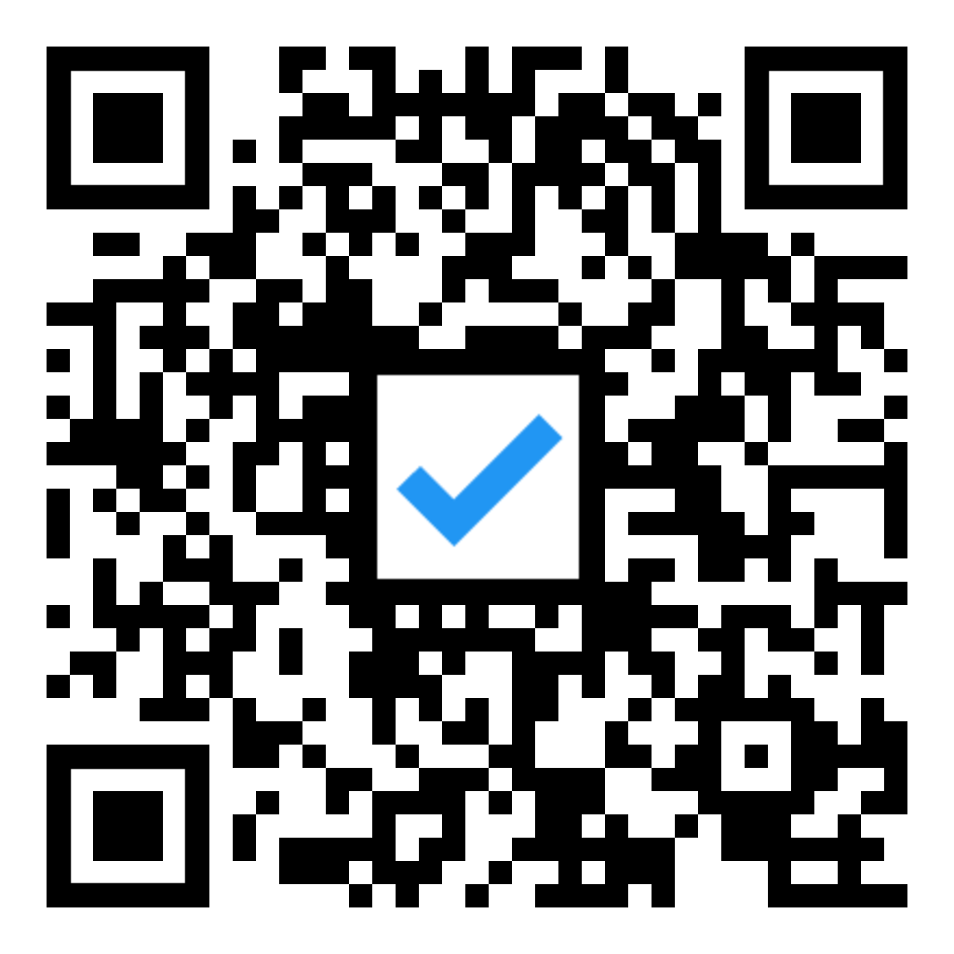
Warm-up
How do you learn best?
Alone, in a quiet spot
With background noise like chatter or music
With others, discussing content
In a lecture
When teaching others

Slide 4
3 minute share
Discuss with your table: Why did you choose those answers and what is your biggest challenge in learning?

Slide 5
Welcome! [Insert the name of your course] [Insert instructor name]
Notes:
Welcome to class!
Participate in some quick icebreakers to get your familiar with Engageli and learn something about each other.

Slide 6
You are heard by everyone only when you are here
Raise hands to move up to the podium
Conversations within the table remain private.

Slide 7
If you’ve heard of Engageli before today.

Slide 8
How excited are you to start this semester? Choose the emoji that most reflects your honest sentiment.

Slide 9
Use your notebook to take a screenshot
Take a screenshot
Annotate - draw the lines
Save your annotation

Slide 10
It’s good to be back!
Summarize your summer experience in one word

