Slide 1
Examples of learning activities powered by Engageli
Notes:
OUTLINE
Intro slide — heavy on l&t background, early looks, dev k-12, this change
Evolution of edu slide … tmw too late, digital transformation
Moved quickly to online
Time to be thoughtful
Challenges
for instructors
Xxx
For learners
Xxx
Strategies
Keep learning in small groups to foster peer-to-peer learning and community
Image: table
Use frequent formative assessments to evaluate understanding and foster learning (circle back then small group convo)
Image: poll w/results
Use real-time feedback to adjust teaching approach
Image: data
Give students flexibility -
in when and how they communicate with you, and each other //
Access class when it works for them (e.g., hybrid) // participation
Multi-modal diagram
Use data to assess participation and engagement
larger scale iteration image?
Support all students equally, regardless of circumstance
Closing
We were starting to do this in-person, was part of the evolution / educator learning trajectory … now we’re being challenged to do it everywhere (online + in-person, at the same time)
Tech can’t make the need to plan for teaching to go away, but can support the teaching moves you want to makes, so you get to focus on the connection with learners and bringing the content alive, not making the classroom work for you
That’s what we’re doing at Engageli — video

Slide 2
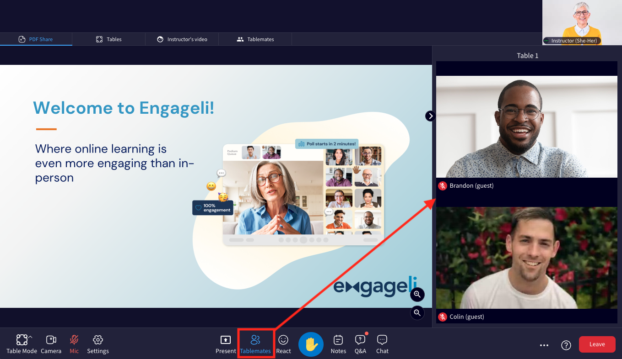
Group Reflection (2-15 minutes)
Set the audio to Table Mode
Use Distribute Documents to share a set of questions with each table to reflect on an activity or topic (these can be the same or different questions for each table).
Set a timer and encourage learners to discuss the questions and their answers at their tables for the allotted time
Request that they choose one representative to share the group’s findings by having them click the “Raise Hand” button, or Requesting learners to raise their hands.
How would you approach problem X?
Share your personal experience with Y.
Why were the outcomes as they are?
What are next steps?
Related Guides: Audio Options | Distributing documents | Setting a Timer | Request Hand Raise

Slide 3
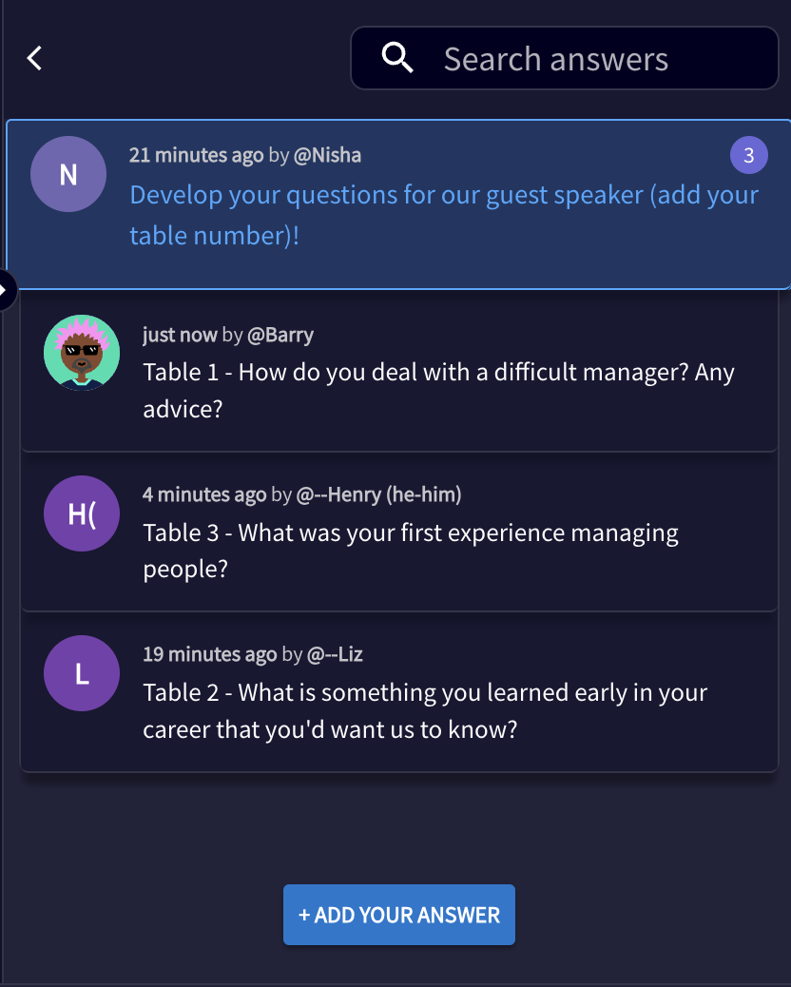
Ask the Expert (10-30 minutes)
Set the audio to Table Mode
Ask learners to work at their tables to develop questions for an expert or guest speaker and create a shared repository of questions
Set a timer for each table to choose one question that they will then post in the Q&A
Moderate the Q&A by asking the expert each question, and allow tables or the whole class to ask follow-up questions
Related Guides: Audio Options | Setting a Timer | Moderating the Q&A

Slide 4
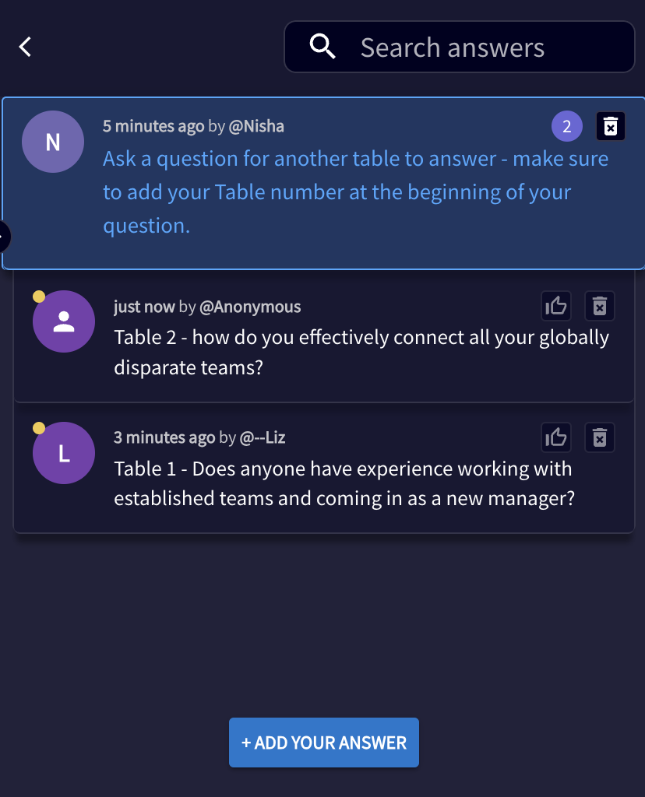
Ask Another Table (10-20 minutes)
Set the audio to Table Mode
Pose a question in the Q&A with the instructions, “Ask a question for another table to answer - make sure to add your Table number at the beginning of your question.”
Ask learners to work at their tables to develop questions for another table to answer, related to presented content or a specific application.
Assign one learner from each table to post their questions as anonymous answers.
Set a timer for 5 minutes
Moderate the Q&A by asking the question aloud allowing representatives from tables to answer anonymously or click the Raise Hand button to answer
Related Guides: Audio Options | Setting a Timer | Moderating the Q&A

Slide 5
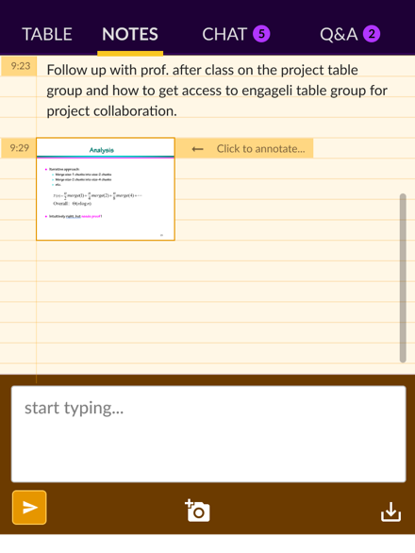
Treasure Hunt (10-30 minutes)
Create a list of questions about this week’s topic and add it to a slide that you screen share with the class
Show students the Notes tab in their platform and ask them each to take a screenshot of the slide using the screenshot tool, located in lower middle section
Ask learners to search the web for answers to the questions, adding it as an annotation to the screenshot
Since Notes are private for each individual, learners can download (lower right section) and share their notes by uploading them to the Chat (for Everyone or just their table), share their screen with the class or just their table, or simply discuss their answers
Related Guides: Share Screen as Instructor | Student Notes | Chat | Share Screen as a Learner

Slide 6
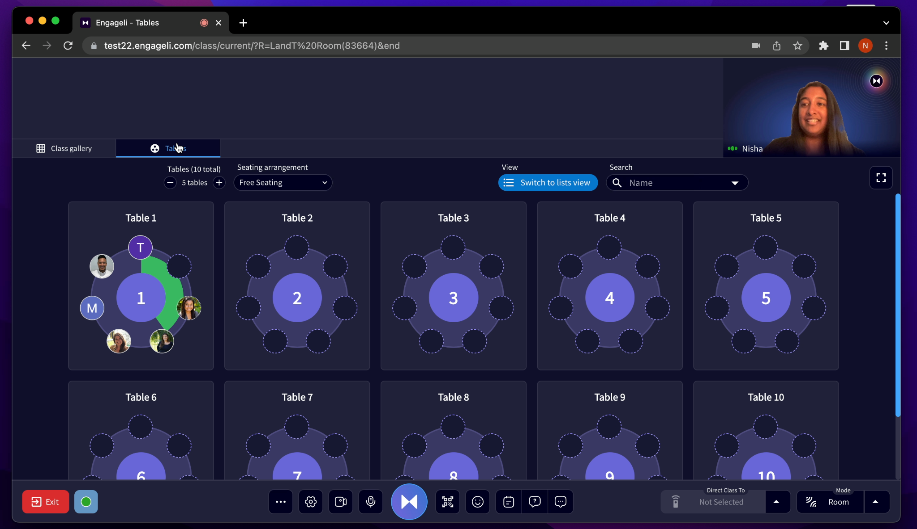
1 Minute Paper (5 minutes)
At the end of a class session, set a 1 minute timer and invite your learners to generate the most significant thing they learned from the session, or one open question they still have.
Post a question in the Q&A with the date of the class session and ask your learners to post their reflections (anonymously if they wish), which you can download
You can also ask them to type it in the Chat (privately to you if they wish), which you can download
Or, as a group activity, ask them to contribute their reflections on a Google doc using Distribute Docs.
Related Guides: Setting a Timer | Moderating the Q&A | Chat | Distributing documents

Slide 7
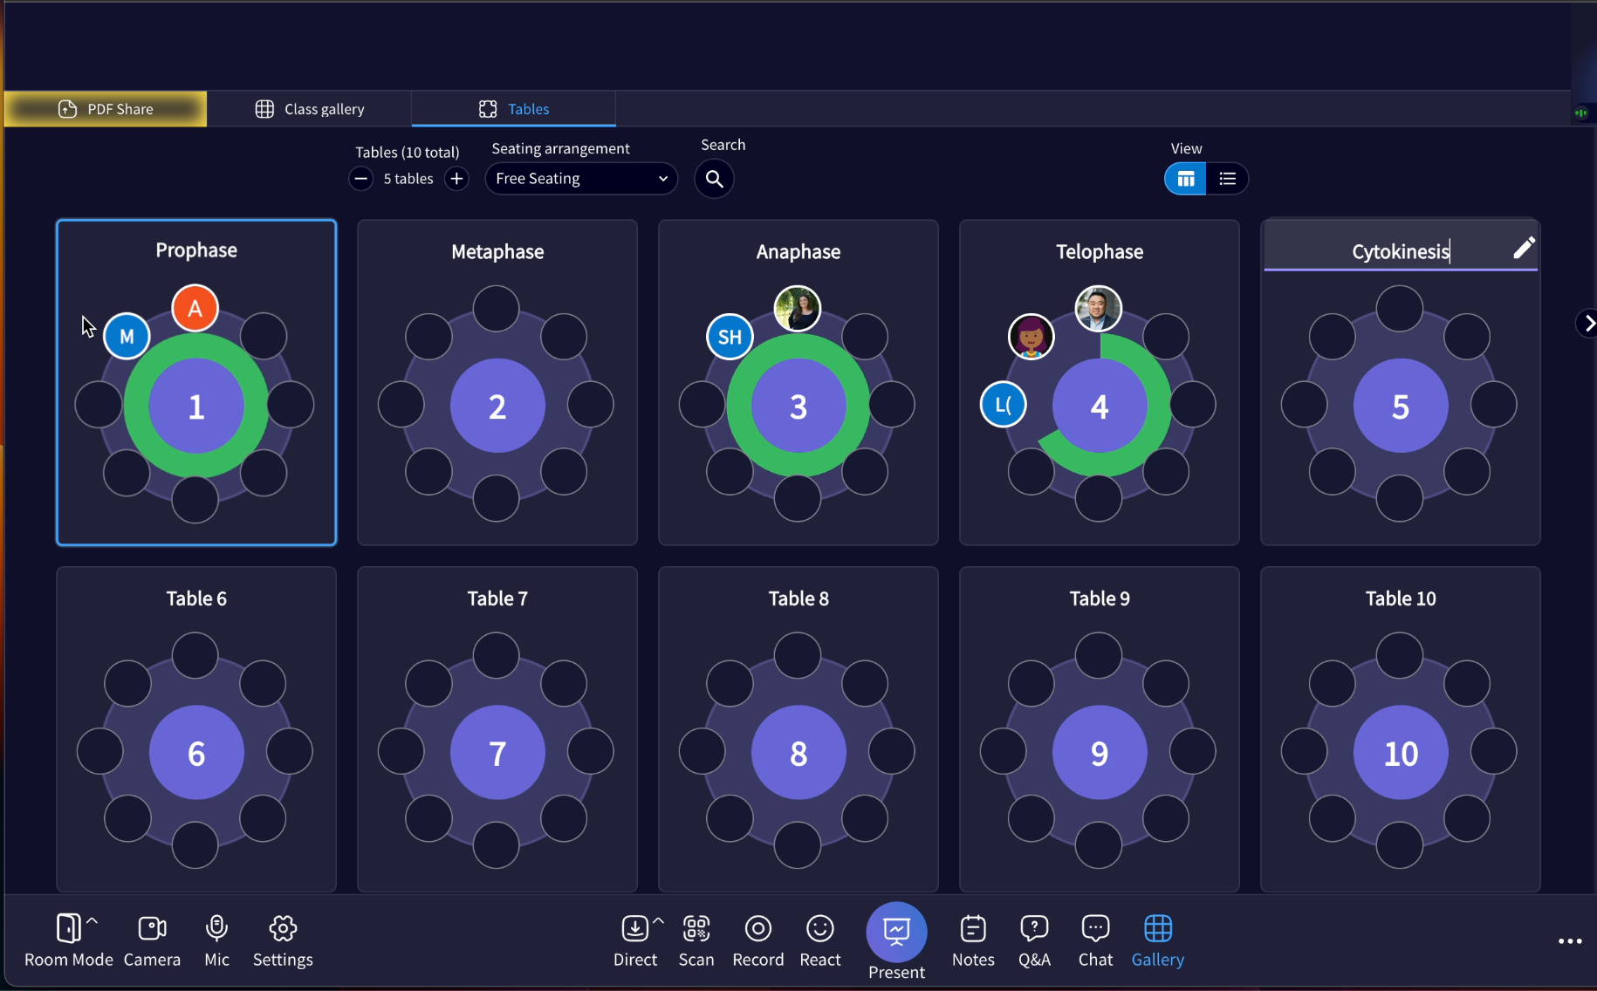
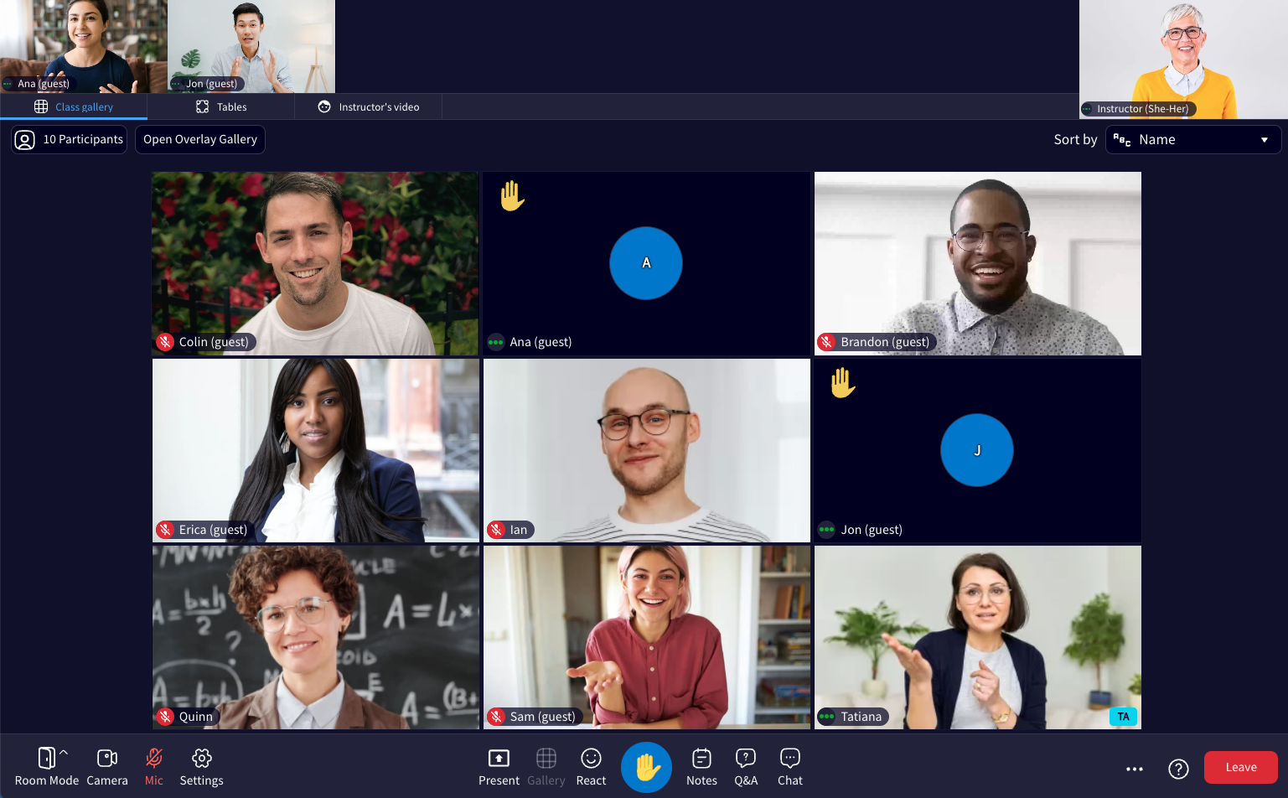
Simplified Jigsaw (20-30 minutes)
Break down a topic into 2-3 subtopics or components and then arrange that number of learners at each table and rename each table with that topic name
Set the audio to Table Mode and set a timer for 20 minutes
Each table group will research that subtopic and develop shared group knowledge using Distribute Documents and choose one representative to share the group’s findings
Request one learner from each table Raise their hand to deliver the information gathered on this subtopic
End with a quiz or poll to explore class progress on the topic as a whole
Related guides: Audio Options | Distributing documents | Setting a Timer | Request Hand Raise | Using a Poll

Slide 8
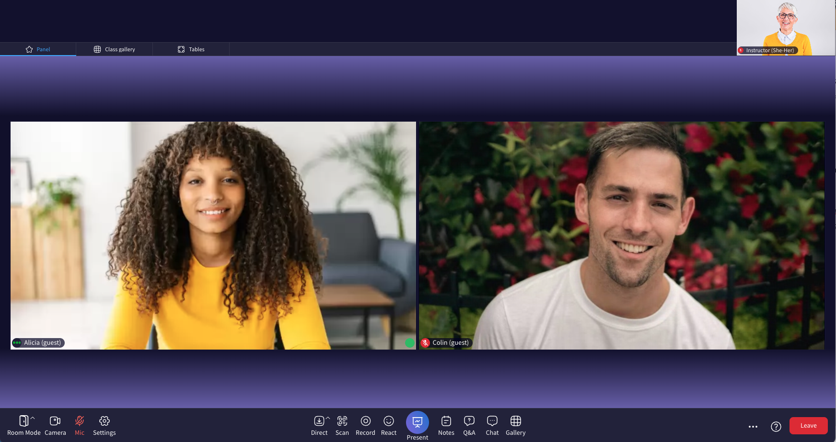
Simplified Jigsaw with Panel (20-30 minutes)
Break down a topic into 2-3 subtopics or components and then arrange that number of learners at each table and rename each table with that topic name
Set the audio to Table Mode and set a timer for 20 minutes
Each table group will research that subtopic and develop shared group knowledge using Distribute Documents and choose one representative to share the group’s findings
Move to Panel and each representative will deliver the information gathered on this subtopic
End with a quiz or poll to explore class progress on the topic as a whole
Related guides: Audio Options | Distributing documents | Setting a Timer | Hosting a Panel | Using a Poll

Slide 9
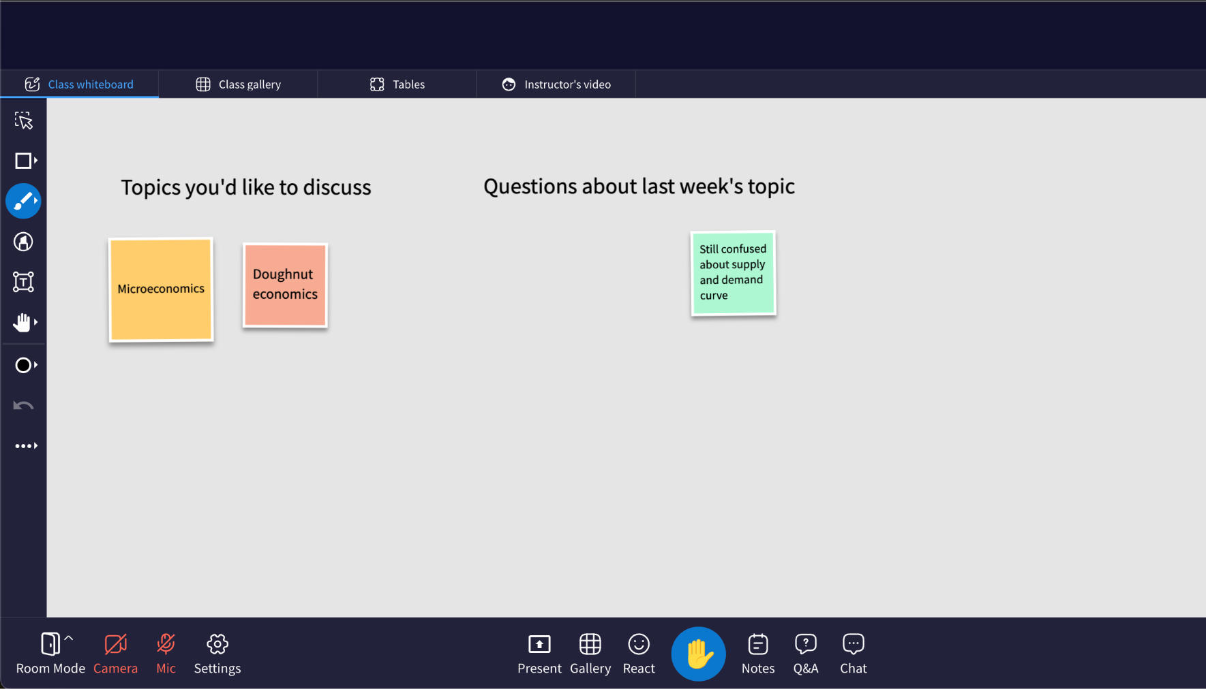
Setting the Agenda (10 minutes)
Open a class-wide whiteboard and share it with the class
Ask learners to add “post-its” to the board in three colors:
An urgent task or concept they’d like to discuss
An issue or question that they have regarding a large concept
An issue or question that related to a micro detail of the content
Set a timer for 5 minutes
Group the post-its as you see emerging themes and use these to direct the class session
Learner’s View: Whiteboard collaboration
Related guides: Class Whiteboard | Setting a Timer

Slide 10
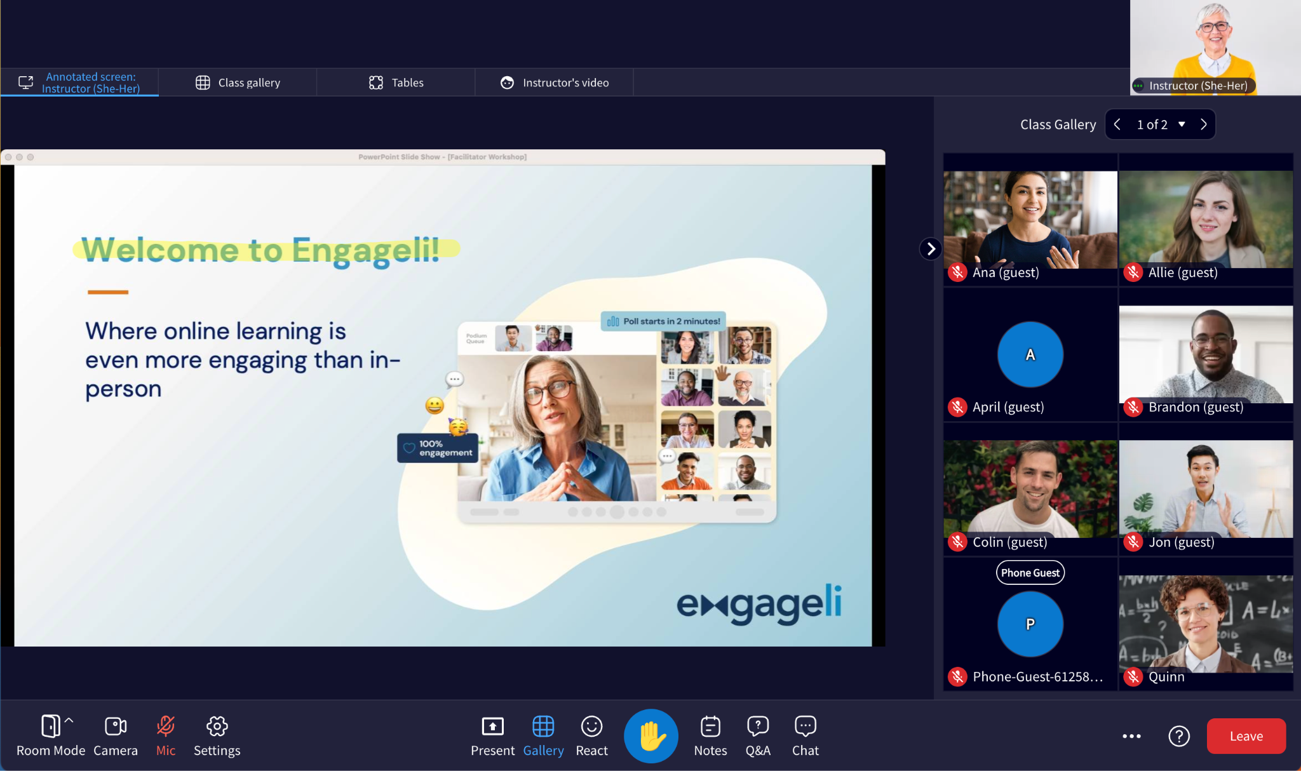
Stop Light (10 minutes)
Use Distribute Docs to share the same Google Sheet with all tables, with “Student X” listed for anonymity, topics in each column and the color coded guide
Set a timer for 5 minutes
Ask learners to copy the cell color (green= understand, yellow = still need help, red = do not understand) that best describes their understanding of 2-3 topics and paste them under their chosen student number
View emerging themes and use these to direct the class session or to encourage peer-to-peer learning
Related Guides: Distributing documents | Setting a Timer

Slide 11
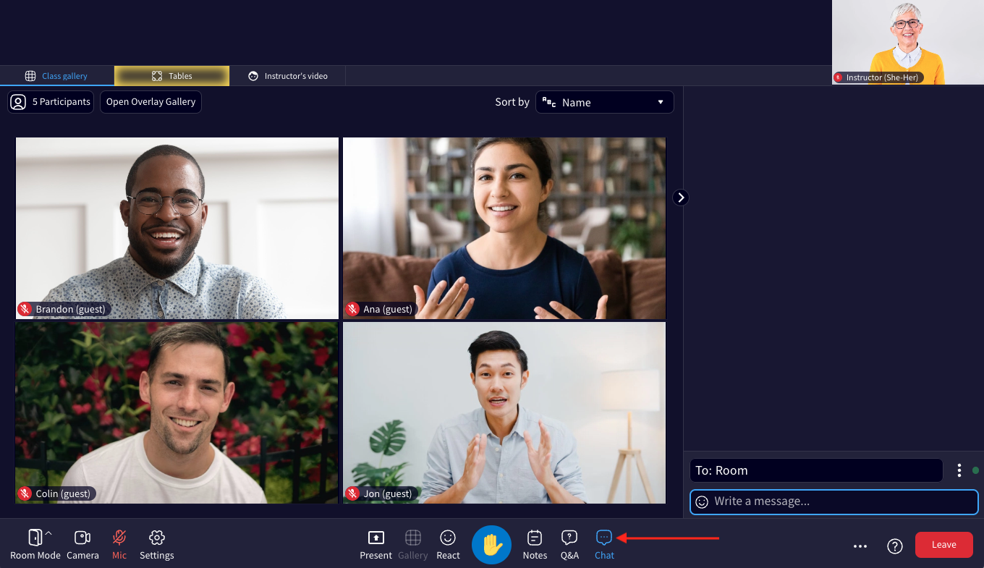
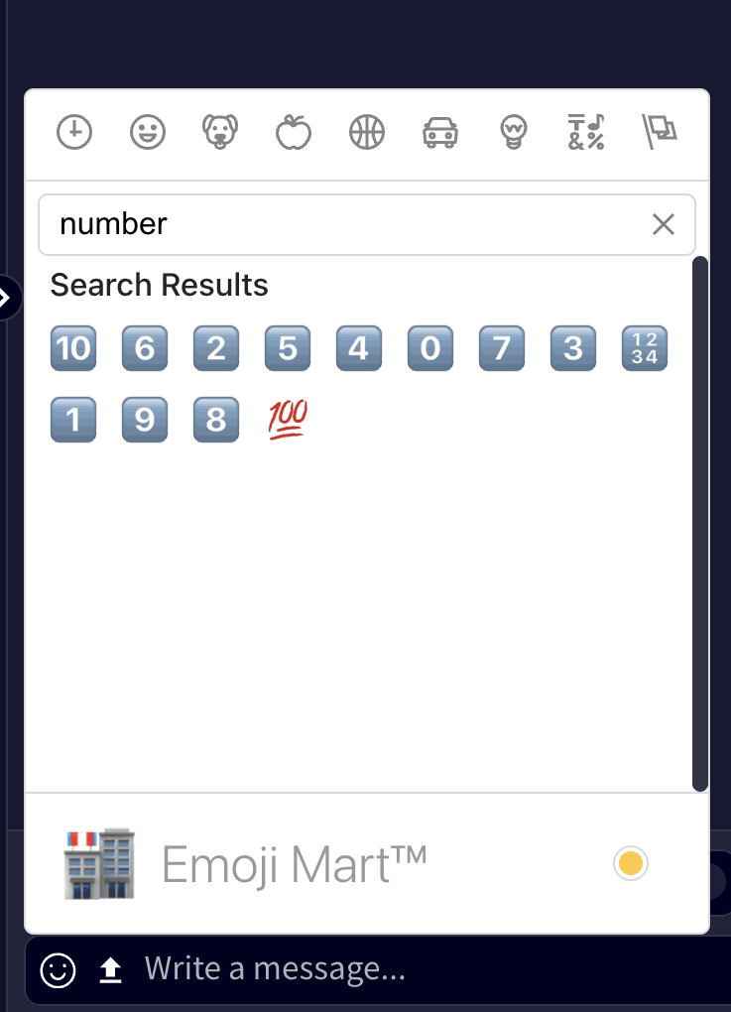
First to Five (3-5 minutes)
Set the audio to Table Mode
Set a timer for 2 minutes
Pose a question to learners, about a concept you just covered or about concepts covered in previous sessions
Direct learners to go to the Chat tab, click the Emoji menu and then type in “number” or “star”
Ask learners to add a number from 1-5, or 1-5 stars to share their level of understanding and to send it as a private message to you
Related Guides: Audio Options | Setting a Timer | Chat

Slide 12
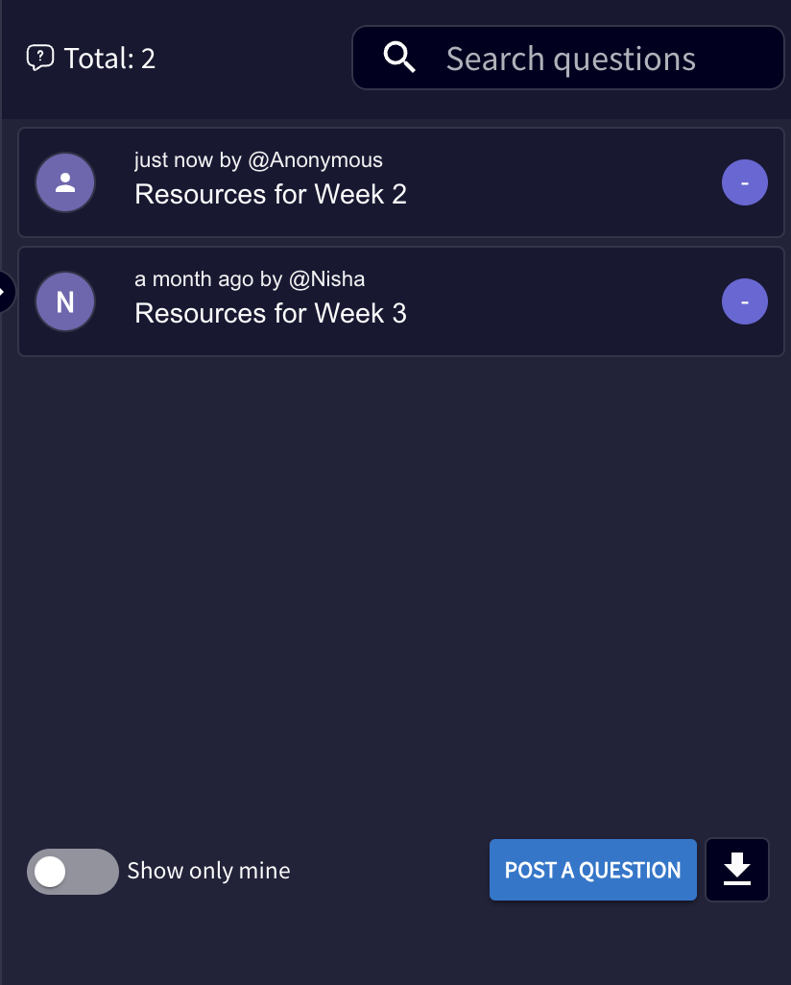
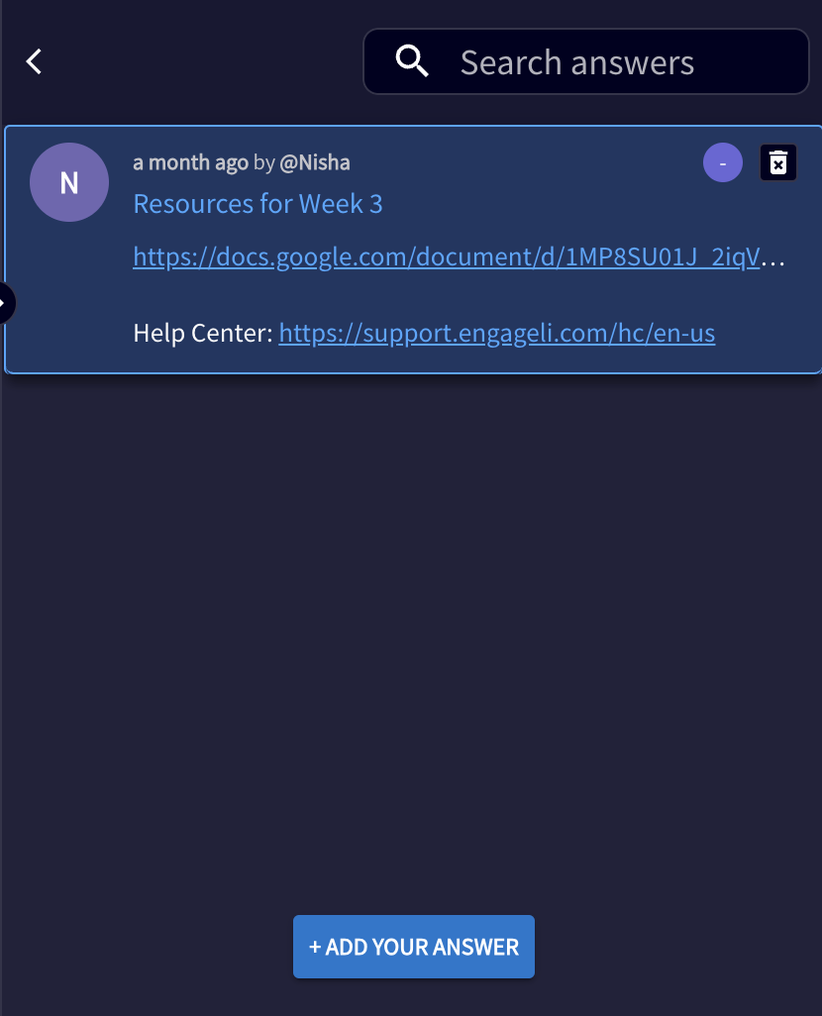
Syllabus Quiz (15 minutes)
Set the audio to Table Mode
Set a timer for 10-15 minutes
Using predetermined questions about the syllabus content, such as assignment due dates, policies and materials, add these to the Q&A tab
Direct learners to review the syllabus and answer the questions in the Q&A tab
Leave time for a group discussion, you can switch the audio to Room Mode
Related Guides: Audio Options | Setting a Timer | Moderating the Q&A

Slide 13
Learning Logs (10 minutes)
Set the audio to Table Mode
Set a timer for 10 minutes
Ask learners to answer one of the following questions at the end of each class, using the Notes tab
Write 3 questions you have about what we did in session today
Explain how something you learned today connects to another lesson
Write the most important idea from today’s lesson
Write 3 questions that might be on the test
Write an explanation to another student of what you learned
What was the most interesting thing you learned today? Why?
What confused you about this lesson?
Ask learners to return to the questions and answers at the end of each unit and use to self-quiz or measure learning progress
Related Guides: Audio Options | Setting a Timer | Student Notes

Slide 14
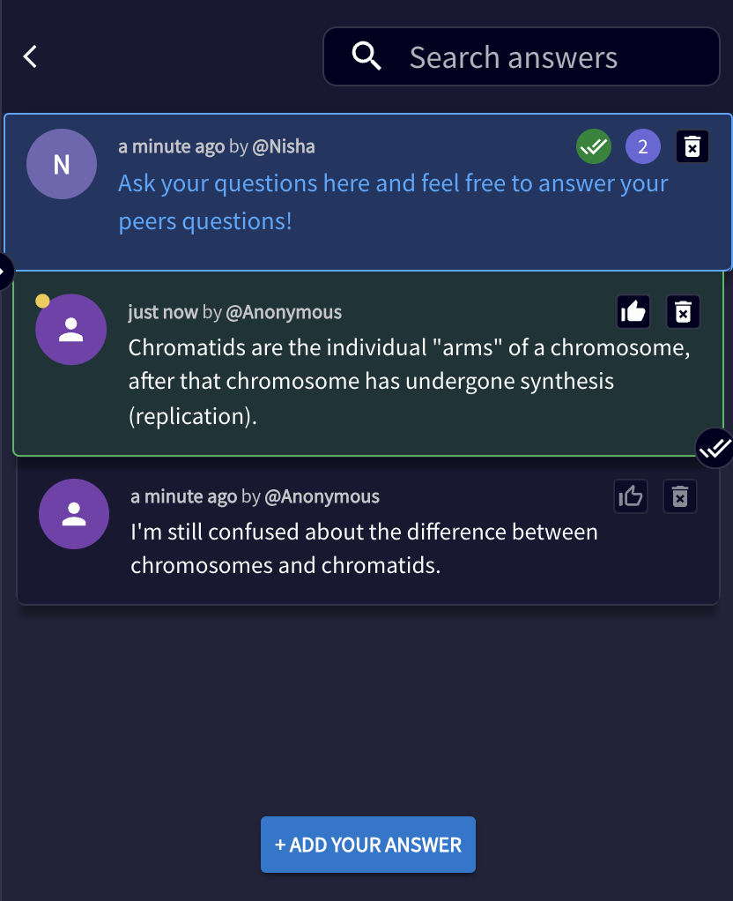
Snowball (10-15 minutes)
Set a timer for 15 minutes
Ask learners to post a question they have or something they don’t understand in the Q&A tab, anonymously
Ask learners to also review posted questions and answer any they wish, anonymously
Leave 5 minutes at the end of the session to either read the questions aloud or ask learners to read them aloud
Encourage learners to discuss and answer questions at their tables or answer them yourself as needed
Related Guides: Setting a Timer | Moderating the Q&A

Slide 15
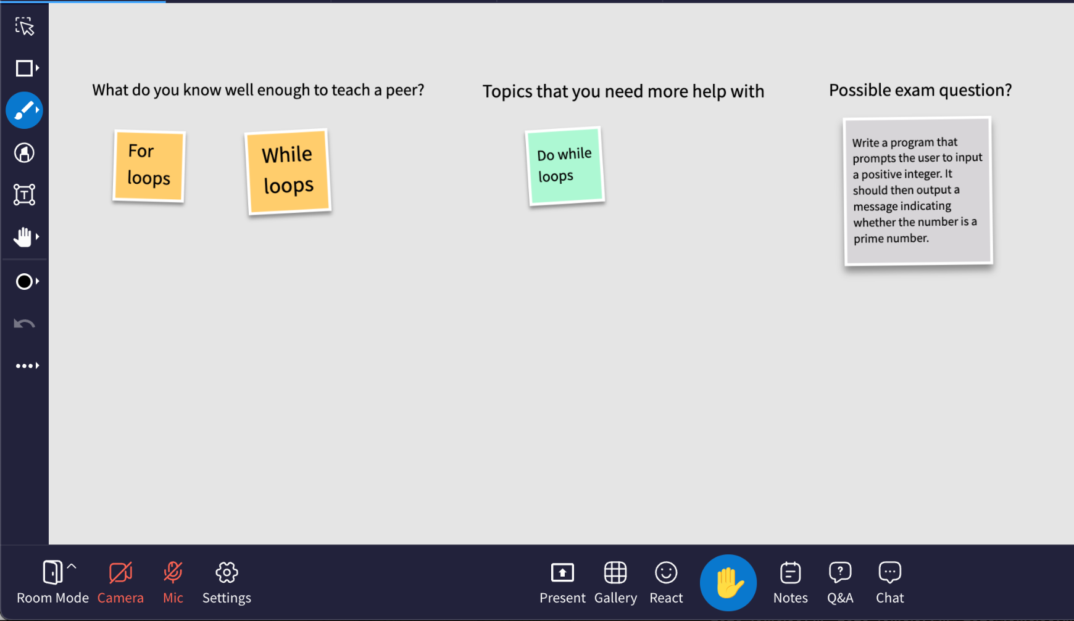
3-2-1 (30 minutes)
Open a class whiteboard and share it with the class
Ask learners to add “post-its” to the board in three colors:
3 topics that they know well enough to “teach” the other students
2 topics they do not understand and need further assistance with
1 possible exam question
Change the names of tables to topics of which learners expressed mastery
Set a timer for 10 minutes
Have learners move to tables and spend 10 minutes discussing and teaching each other about the labeled topic; rotate and repeat for 3-5 topics
Learner’s View: Whiteboard collaboration
Related guides: Class Whiteboard | Setting a Timer | Naming Tables

Slide 16
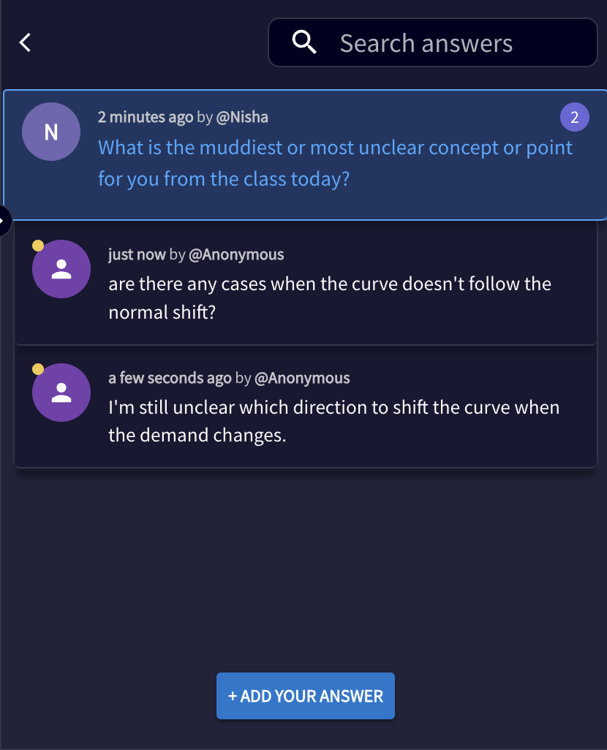
Clear Skies, Muddy Waters (10 minutes)
Post 2 separate questions in the Q&A tab at the end of class - “What is the clearest or most important thing they learned from class today?” and “What is the muddiest or most unclear concept or point for you from the class today?”
Set a timer for 10 minutes
Ask learners answer both, anonymously if they wish
Use these answers to set the agenda for following sessions
Related Guides: Setting a Timer | Moderating the Q&A

Slide 17
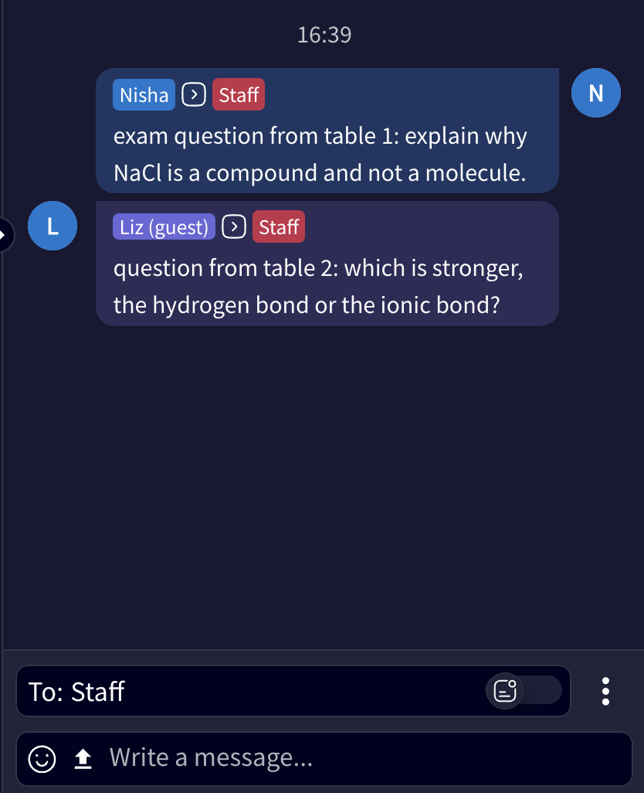
Team Quiz (35-50 minutes)
Set the audio to Table Mode
Arrange learners randomly into groups of 3-5 learners at each table
Set a timer for 15 minutes
Ask learners at each table to create 3-5 quiz questions and send them in the Chat to the Instructor only
Set a timer for 20 minutes
As the Instructor, pose the quiz questions to those at other tables and let them discuss as a table and provide a unified answer, encouraging one learner to click the Raise Hand button to share with the whole class (rotate as needed)
Leave 5-10 minutes to discuss answers as needed
Related Guides: Audio Options | Setting a Timer | Chat

Slide 18
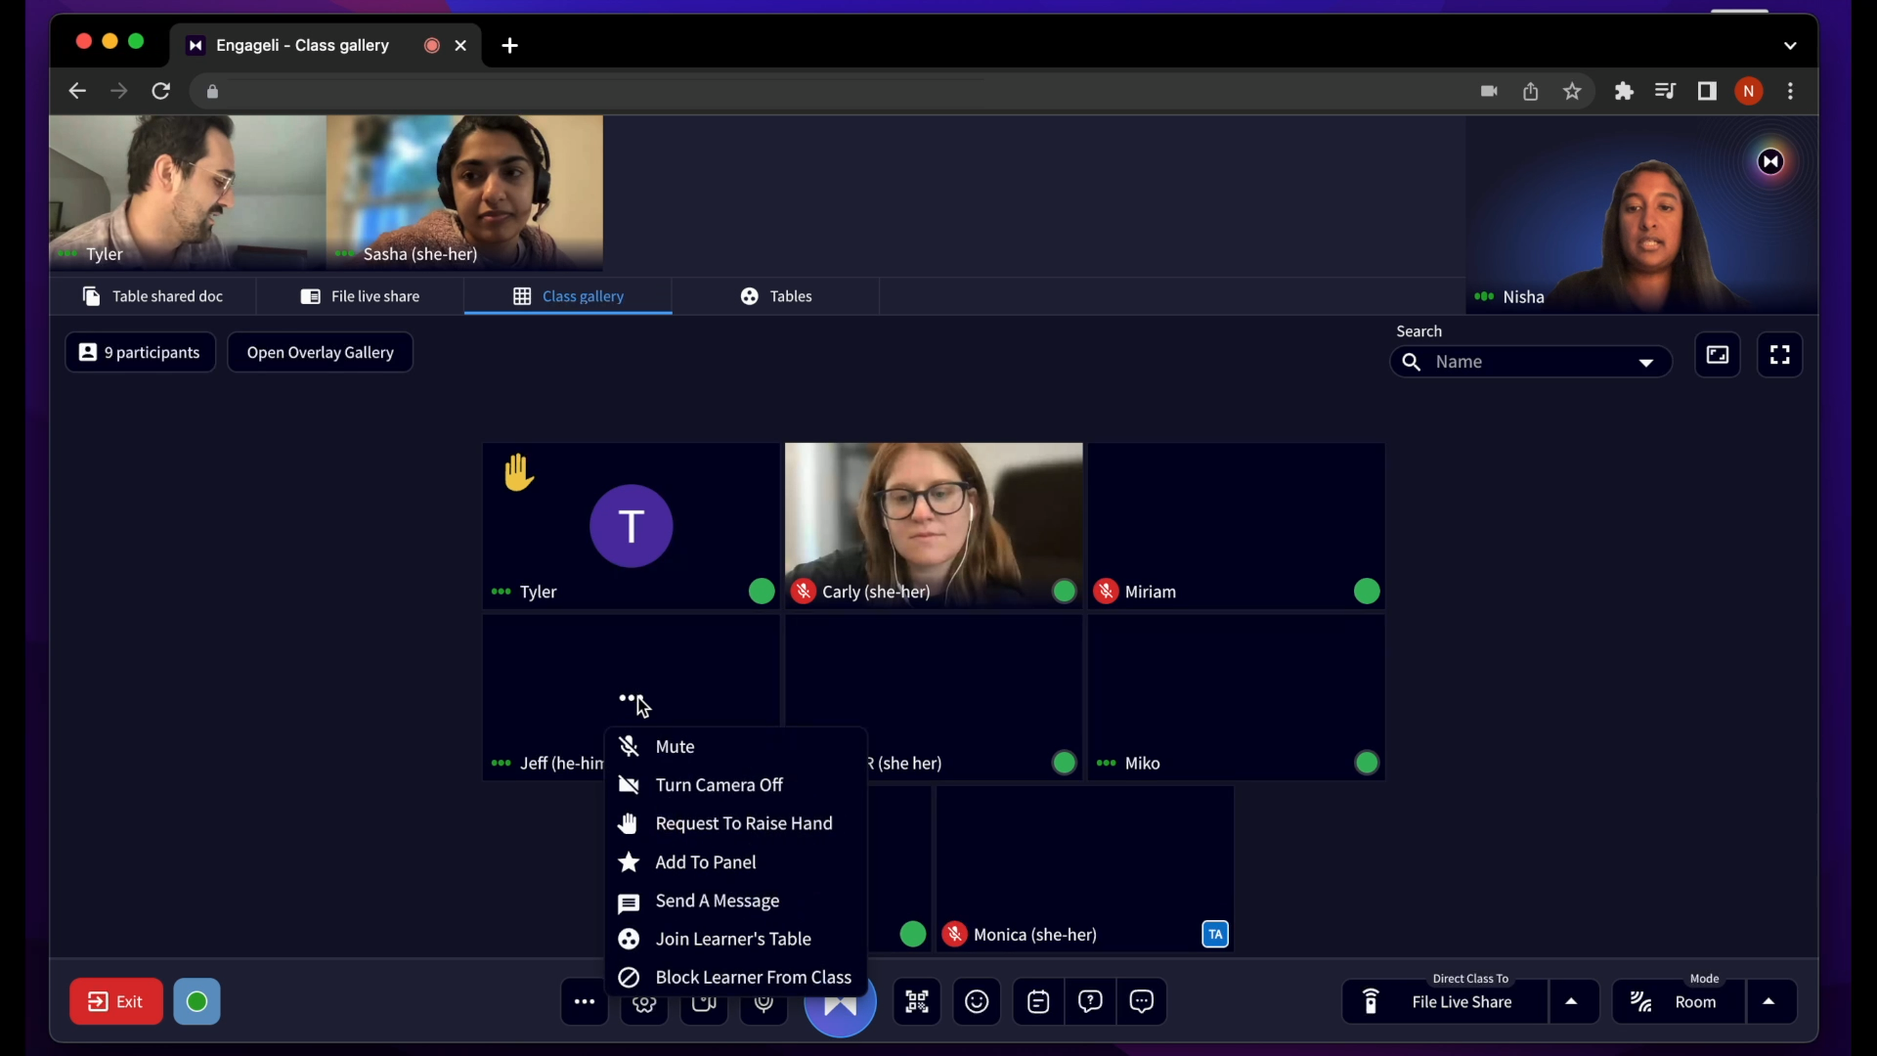
Verbal Volleyball (20-30 minutes)
Set the audio to Table Mode
Set a timer for 20-30 minutes
Have a list of pre-made quiz questions
Choose a learner at random and click the “Request to Raise Hand” button
Once at the podium, ask a quiz question for the learner to answer
This learner gets to choose the next learner at random to Raise their Hand and answer the next question
Continue to get learners to “volleyball” concepts until all of their ideas are exhausted
Leave 5-10 minutes to discuss answers as needed
Instructor’s View: Individual learner menu
Related Guides: Audio Options | Setting a Timer | Request Hand Raise

Slide 19
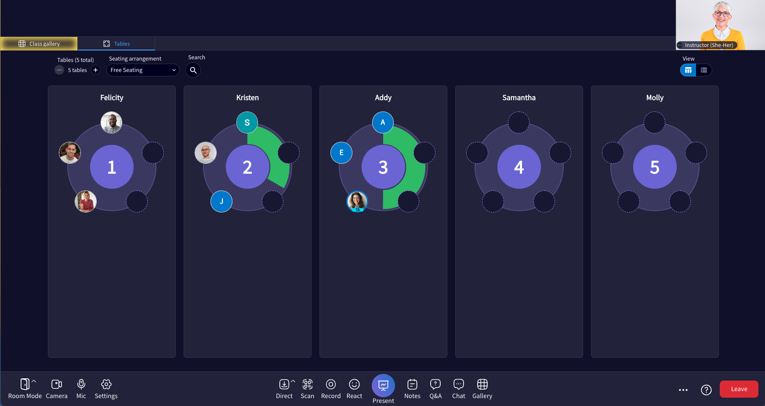
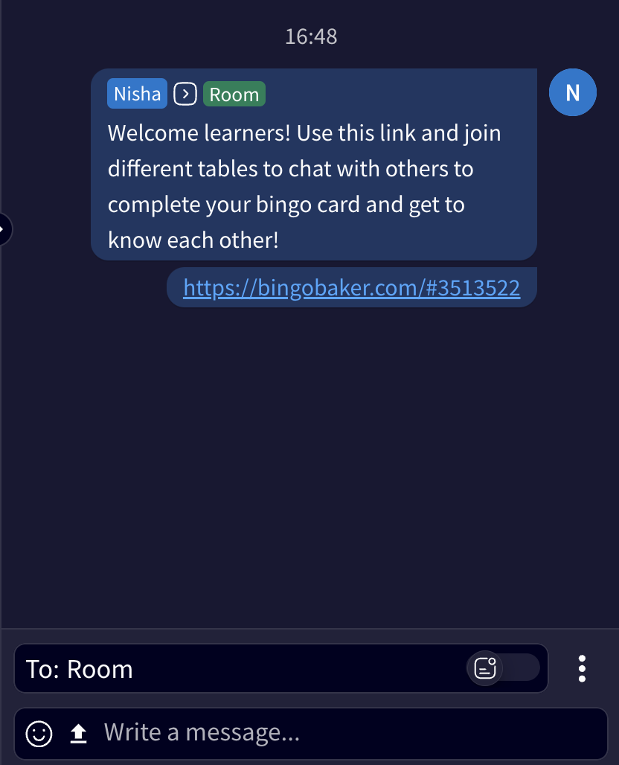
Get to Know You Bingo (20-30 minutes)
Set the audio to Table Mode
Set a timer for 20-30 minutes
Use any of these Get to Know You Bingo templates (https://bit.ly/GTKYBingo) and upload it to the Chat
Encourage learners to join different tables and try to complete their Bingo card by getting to know their peers
When a learner gets Bingo, have them click the Raise Hand icon and share what they learned about their peers
Instructor’s View: Tables
Related Guides: Audio Options | Setting a Timer | Join Tables - Learner | Request Hand Raise

Slide 20
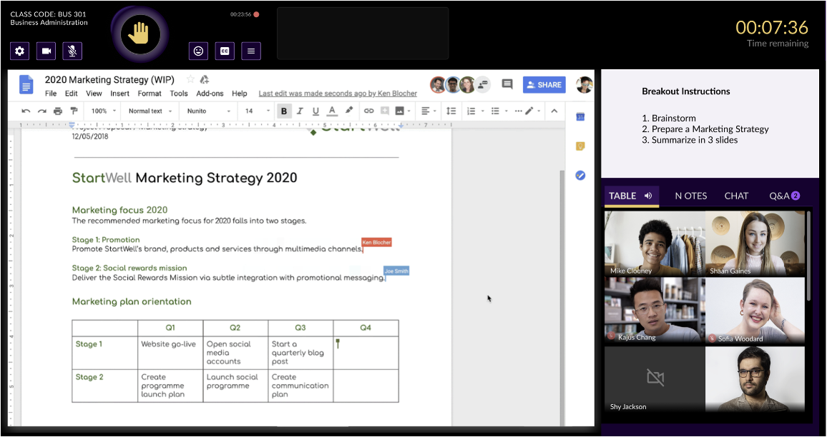
Summarize the Lecture v1 (10-15 minutes)
Set the audio to Table Mode
Use Distribute Documents to share a Google doc to each table with prompts that help learners summarize the concepts presented in the session (these can be one doc or different for each table).
Set a timer for 10-15 minutes
Encourage learners to work together at their tables to summarize and detail the takeaways from the session in the doc (ask them to try not to review their Notes, but rather try to recall from memory)
Related Guides: Audio Options | Setting a Timer | Distributing documents

Slide 21
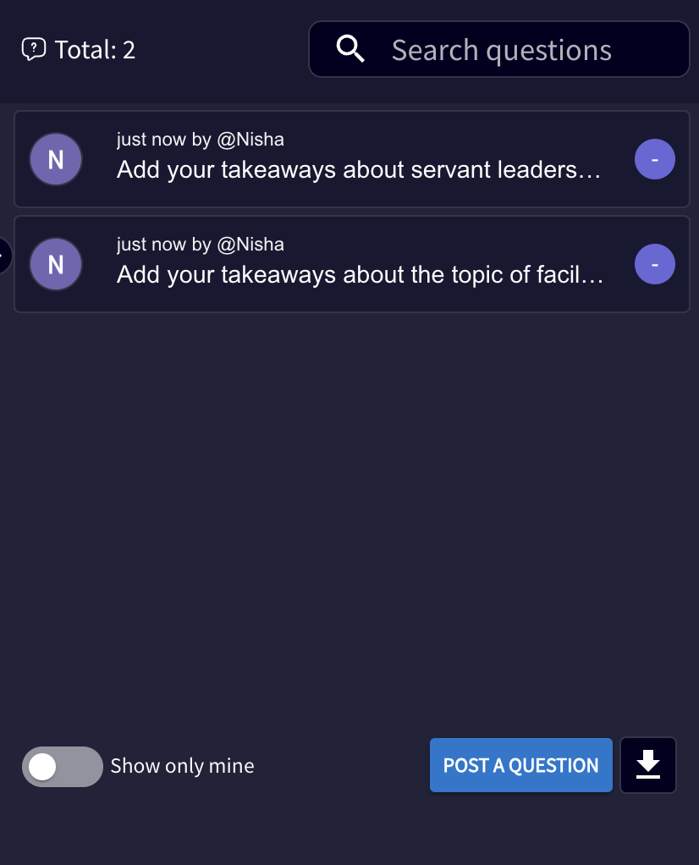
Summarize the Lecture v2 (10-15 minutes)
Set the audio to Table Mode
Set a timer for 10-15 minutes
Encourage learners to work together at their tables to summarize and detail the takeaways from the session (ask them to try not to review their Notes, but rather try to recall from memory)
Use the Q&A to list prompts that help learners summarize the concepts presented in the session and have a representative from each table post their summary for each prompt in the Q&A
Related Guides: Audio Options | Setting a Timer | Join Tables - Learner | Request Hand Raise

Slide 22
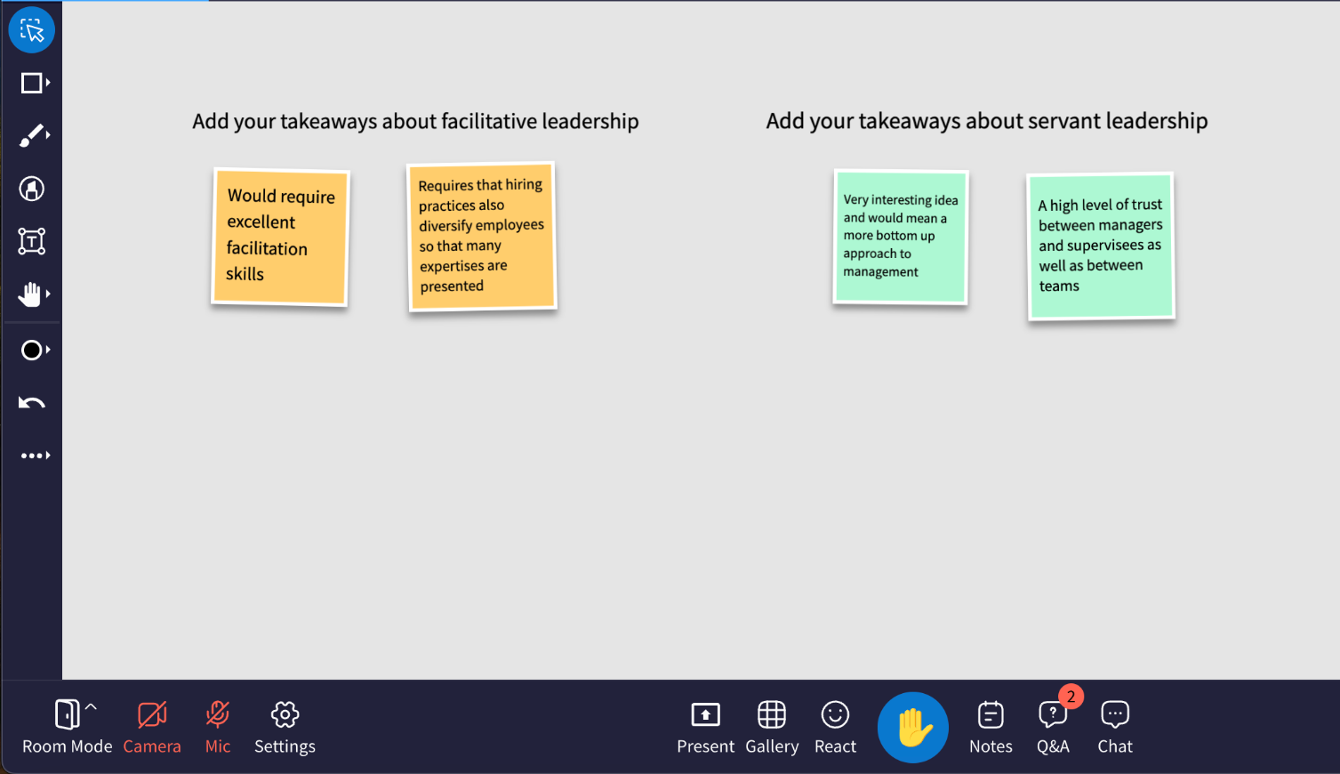
Summarize the Lecture v3 (10-15 minutes)
Set the audio to Table Mode
Open a Class Whiteboard
Set a timer for 10-15 minutes
Encourage learners to work together at their tables to summarize and detail the takeaways from the session (ask them to try not to review their Notes, but rather try to recall from memory)
Have one representative from each table to list their summaries for each concept on the whiteboard
Learner’s View: Whiteboard collaboration
Related guides: Class Whiteboard | Setting a Timer

Slide 23
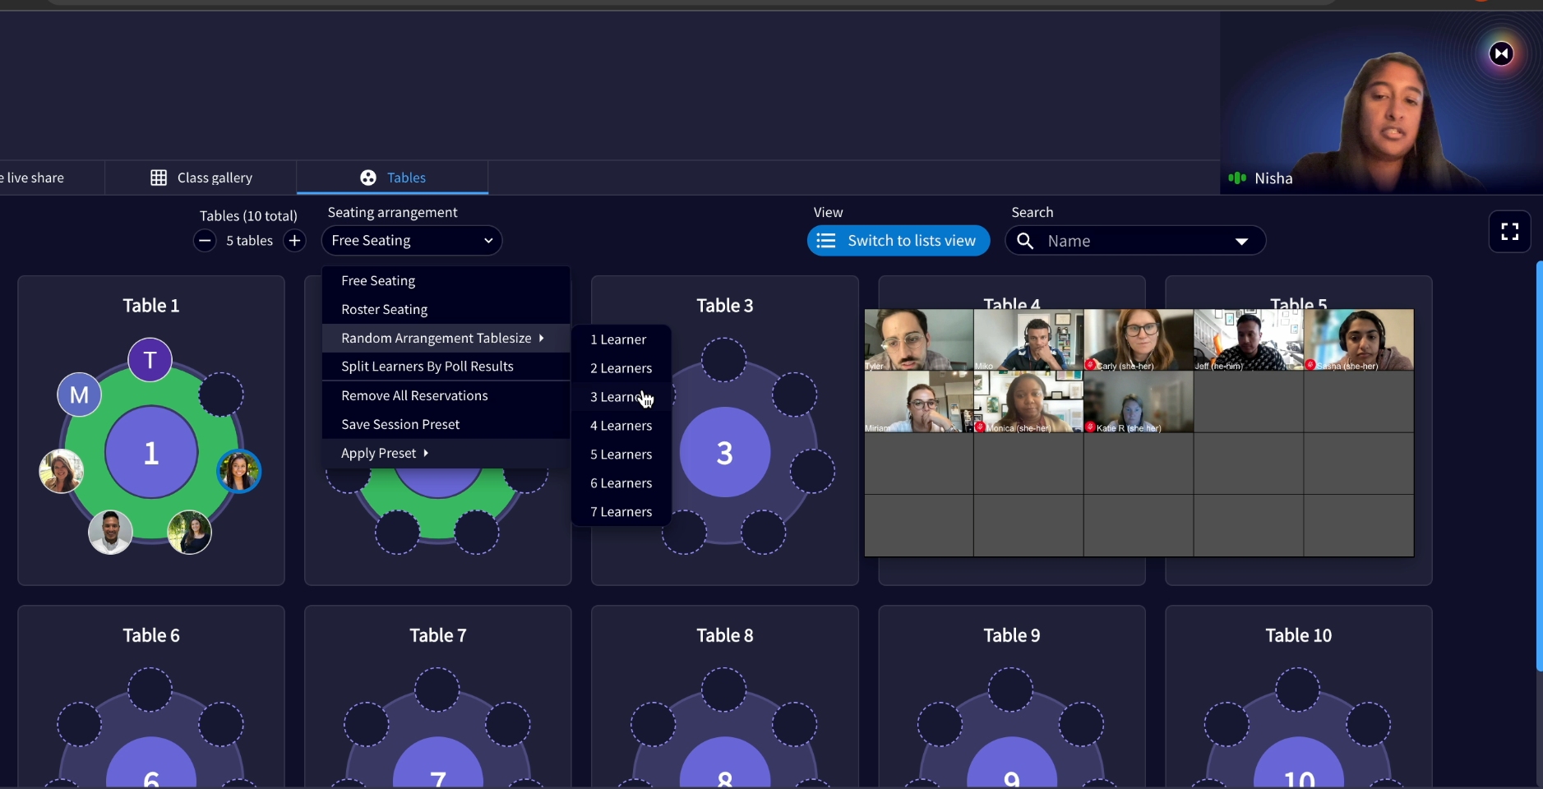
Think-Pair-Share (10-15 minutes)
Set the audio to Table Mode
Set a timer for 5 minutes
Provide a prompt and encourage individual learners to spend 2-5 minutes thinking about their answer silently and writing their thoughts in the Notes tab
After 5 minutes, set another timer for 10 minutes
Distributes 2 learners per table and encourage learners to discuss the questions and their answers in pairs
After the time has elapsed, have each pair of learners click the Raise Hand button to come to the Podium and share their answers to the prompt
Instructor’s View: Tables
Related Guides: Audio Options | Setting a Timer | Creating Random Table Groups | Request Hand Raise

Slide 24
Jigsaw (30-50 minutes)
Break down a topic into 2-3 subtopics or components and then arrange that number of learners at each table; rename the tables with the name of each sub-topic
Set the audio to Table Mode
Set a timer for 15-20 minutes
Each table group will research that subtopic and develop shared group knowledge
Have 1 learner from each table distribute to 2-3 tables, and now act as the representative for that subtopic, and explain their subtopic to the other learners; set a timer for 20 minutes
End with a whole group discussion, poll or panel to discuss takeaways
1
1
Marketing
Engineering
2
2
3
Sales
3
Related guides: Audio Options | Naming Tables | Setting a Timer | Creating Random Table Groups

Slide 25
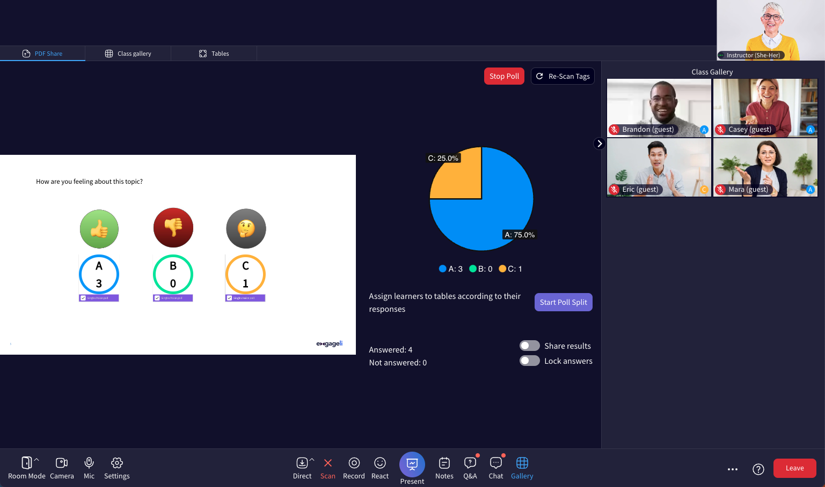
Informal Quiz (10-15 minutes)
Create 5-7 quiz questions and translate them to a set of Polls
Set the audio to Room Mode
Set a timer for 10-15 minutes
Present the polls and lock the results after 2-3 minutes, but do not share the results
Encourage learners to try to answer by recall, but they can refer to their notes
After all polls are completed, follow with a short debrief and allow time for other learners to concur or disagree and encourage discussion
Related Guides: Audio Options | Setting a Timer | Create a Poll |

Slide 26
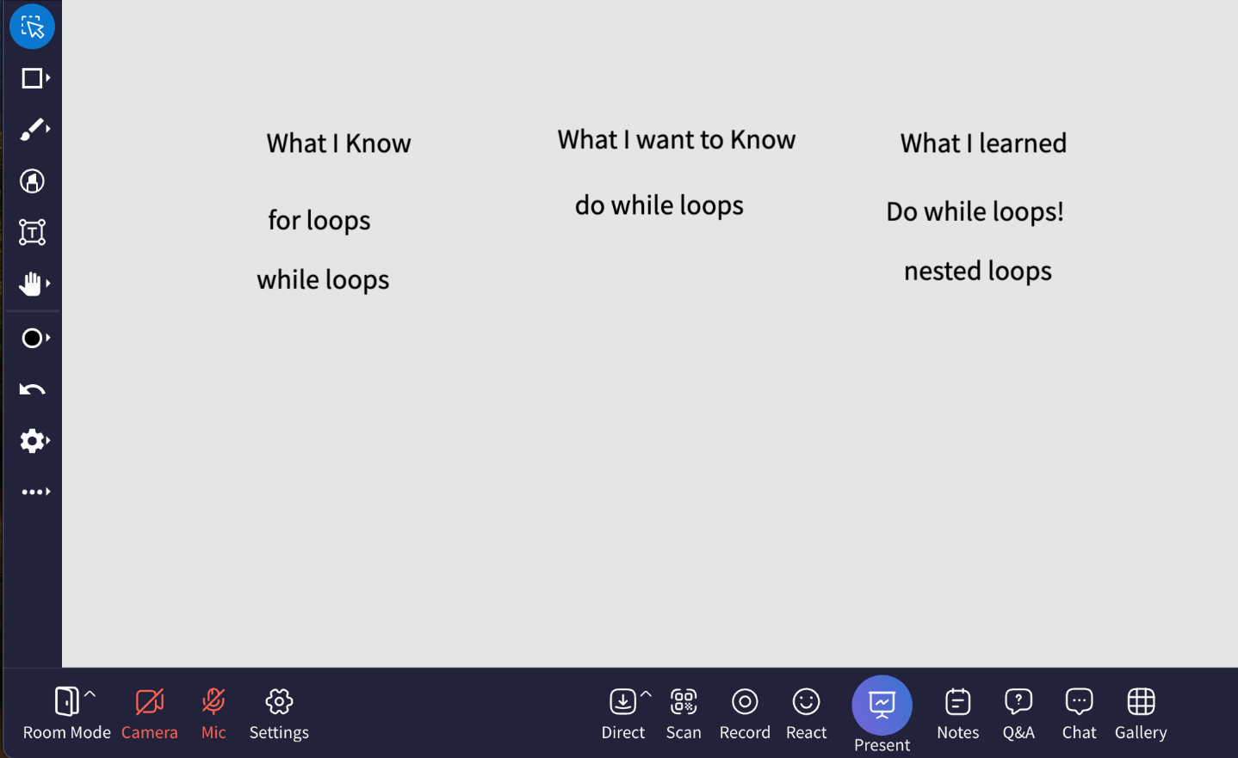
K.W.L. (Know-Want-Learned) v1 (10-15 minutes)
At the start of class, open a class whiteboard
Set a timer for 10 minutes
Ask learners to contribute to the board about a topic, or about the previous class session, in two columns:
What I Know (K)
What I Want to Know (W)
Towards the end of the session, share the class whiteboard again
Set a timer for 5 minutes
Ask learners to review the “Know” information if any needs to be corrected, mark any “Want” questions left unanswered
Ask them to add “post-its” to a third column, “Learned” (L) about what they’ve learned from today’s session
Related Guides: Audio Options | Setting a Timer | Class Whiteboard

Slide 27
K.W.L. (Know-Want-Learned) v2 (10-15 minutes)
At the start of class, use Distribute Documents to share a Google doc with all learners
Set a timer for 10 minutes
Ask learners to contribute to the doc about a topic, or about the previous class session, in two columns:
What I Know (K)
What I Want to Know (W)
Towards the end of the session, share the Google doc again
Set a timer for 5 minutes
Ask learners to review the “Know” information if any needs to be corrected, and mark any “Want” questions left unanswered
Ask them to contribute to a third column, “Learned” (L) about what they’ve learned from today’s session
Related Guides: Audio Options | Distributing documents | Setting a Timer

Slide 28
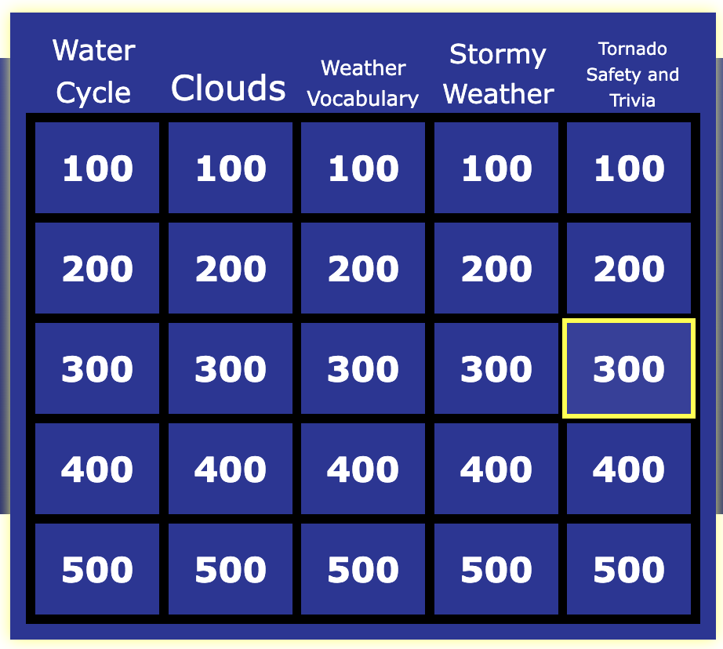
Jeopardy (30-50 minutes)
Learner’s View
Use jeopardylabs.com to find free templates and generate 30-35 questions to enter into the template and share your screen
Distribute 3-4 learners at random into tables
Set the audio to Table Mode
Share the rules of Jeopardy:
They can discuss what they want to answer at their Table verbally or using the “My Table” chat channel
Rotate the learner that answers from each table, by using the Raise Hand button
If a team misses a question, another team can steal
Questions are posed to tables in order, so all learners get to participate
Instructor’s View: Tables
Related Guides: Audio Options | Creating Random Table Groups | Sharing Screen as Instructor | Setting a Timer

Slide 29
Reciprocal Think-Alouds v1 (20-30 minutes)
Set the audio to Table Mode
Distribute 2 learners to each Tables
Use Distribute Documents to share a Google doc to each table with prompts (see on the right).
Instruct learners to take turns thinking aloud as they read a difficult text, form a hypothesis, or compare opposing points of view.
While the first learner is thinking aloud, the second learner listens and records. Then the pair change roles so that each has a chance to think aloud and observe the process.
Next, learners reflect on the process together, what they tried, what worked and what didn't. As they write about their findings, they can start a mutual learning log.
Set a timer for 10-15 minutes for each turn
What do I already know about this topic?
What do I think I will learn about this topic?
Did I understand what I just read?
What were the most important points in this reading?
What new information did I learn?
How does it fit in with what I already know?
Related Guides: Audio Options | Creating Random Table Groups | Distributing documents | Setting a Timer

Slide 30
Reciprocal Think-Alouds v2 (20-30 minutes)
Set the audio to Table Mode
Distribute 2 learners to each Tables
Ask learners to use the Notes section to answer the prompts (see on the right).
Instruct learners to take turns thinking aloud as they read a difficult text, form a hypothesis, or compare opposing points of view.
While the first learner is thinking aloud, the second learner listens and records in the Notes. Then the pair change roles so that each has a chance to think aloud and observe the process.
Next, learners reflect on the process together, what they tried, what worked and what didn't. As they write about their findings, they can start a mutual learning log in the Notes, download them and upload them to the chat to share in the “My Table” channel
Set a timer for 10-15 minutes for each turn
What do I already know about this topic?
What do I think I will learn about this topic?
Did I understand what I just read?
What were the most important points in this reading?
What new information did I learn?
How does it fit in with what I already know?
Related Guides: Audio Options | Creating Random Table Groups | Distributing documents | Setting a Timer

Slide 31
Word Wall v1 (10-15 minutes)
At the start of each class, open a class whiteboard and share it with the class
Set a timer for 10 minutes
Ask learners to spend the next 10 minutes reviewing and contributing to the whiteboard with post-its or text boxes that can include definitions, examples, illustrations, and real-world connections
Download the whiteboard as an image and share it in your LMS so that learners can refer back to it at any time
The Word Wall will now be a repository of knowledge, information and connected content for learners to use for their own study and learning process
Related Guides: Audio Options | Setting a Timer | Class Whiteboard |

Slide 32
Word Wall v2 (10-15 minutes)
At the start of each class, Distribute the same Google doc to all tables
Set a timer for 10 minutes
Ask learners to spend the next 10 minutes reviewing and contributing to the doc, which can include definitions, examples, illustrations, and real-world connections
Share the link to all learners in your LMS or the Q&A tab so that learners can refer back to it at any time
The Word Wall will now be a repository of knowledge, information and connected content for learners to use for their own study and learning process
Related Guides: Audio Options | Creating Random Table Groups | Distributing documents | Setting a Timer

Slide 33
Three Before Me (no time limit)
This is a strategy to model at the beginning of the course and to use throughout. This can help with redirecting questions to promote learner independence and to encourage peer-to-peer interaction
When a learner asks a question during a session, have a minimum of 3 students (or less depending on the size of your course) try to answer the question before you will answer the question as the instructor
Direct learners to post and answer their questions in the Q&A tab
As the instructor, you can moderate the answers by verifying them or contributing answers yourself
Related Guides: Moderating the Q&A

Slide 34
Table/Gallery Walk (20 minutes)
Open Table whiteboards
Ask learners to add their ideas and comments to their table whiteboard
You can provide additional structure by asking learners to construct a scrum board, concept map, takeaways from a short lecture or case study debrief
Set a timer for 5 minutes
Once the time elapses, ask learners to rotate to the immediate next table and access the Table whiteboard, continuing till learners return to their original table
Learners can gain new understandings from other groups, fill in gaps or contribute new ideas
Related Guides: Audio Options | Table whiteboards | Setting a Timer

Slide 35
Case Study Analysis (15-20 minutes)
Open Table whiteboards or Distribute docs for individual tables
Pin the case study file to the table whiteboard OR
Configure the Google doc with the case study details
Ask learners to analyze the case study as a group
Set a timer for 15 minutes
If desired, once the time elapses, ask learners to rotate to the immediate next table and access the Table whiteboard or Google doc continuing till learners return to their original table
Learners can gain new understandings from other groups’ work, fill in gaps or contribute new ideas
Related Guides: Audio Options | Distributing documents | Table whiteboards | Setting a Timer

Slide 36
Real World Application (15-20 minutes)
Edit tables names according to learner groups
Can use group project names
Can use department, role, type of work
Open Table whiteboards or Distribute docs for individual tables
Allow learners to join the appropriate table or arrange them using a preset
Ask learners to work together to detail how they will use what was presented in a real world scenario
This can be how they will apply what was presented in their own group work or role
Set a timer for 15 minutes
Related Guides: Audio Options | Naming Tables | Distributing documents | Table whiteboards | Setting a Timer

Slide 37
Stump the Instructor/Trainer (15-20 minutes)
Set the audio to Table Mode
Use Distribute Docs or Table whiteboards for each table
Ask learners to work at their tables to develop questions that they’d like to pose to you as the instructor or trainer
Encourage learners to think of complex questions
Set a timer for each table to choose one question that they will then post in the Q&A (anonymously is best)
Moderate the Q&A by reading each question and providing answers as well as allowing time follow-up questions
Related Guides: Audio Options | Distributing documents | Table whiteboards | Moderating the Q&A | Setting a Timer

