Slide 1
Polls Repository
Navigate to the desired poll or a quiz
Click on “Activate Tag”
Engage learners with interactive polls and track results
Notes:
OUTLINE
Intro slide — heavy on l&t background, early looks, dev k-12, this change
Evolution of edu slide … tmw too late, digital transformation
Moved quickly to online
Time to be thoughtful
Challenges
for instructors
Xxx
For learners
Xxx
Strategies
Keep learning in small groups to foster peer-to-peer learning and community
Image: table
Use frequent formative assessments to evaluate understanding and foster learning (circle back then small group convo)
Image: poll w/results
Use real-time feedback to adjust teaching approach
Image: data
Give students flexibility -
in when and how they communicate with you, and each other //
Access class when it works for them (e.g., hybrid) // participation
Multi-modal diagram
Use data to assess participation and engagement
larger scale iteration image?
Support all students equally, regardless of circumstance
Closing
We were starting to do this in-person, was part of the evolution / educator learning trajectory … now we’re being challenged to do it everywhere (online + in-person, at the same time)
Tech can’t make the need to plan for teaching to go away, but can support the teaching moves you want to makes, so you get to focus on the connection with learners and bringing the content alive, not making the classroom work for you
That’s what we’re doing at Engageli — video

Slide 2
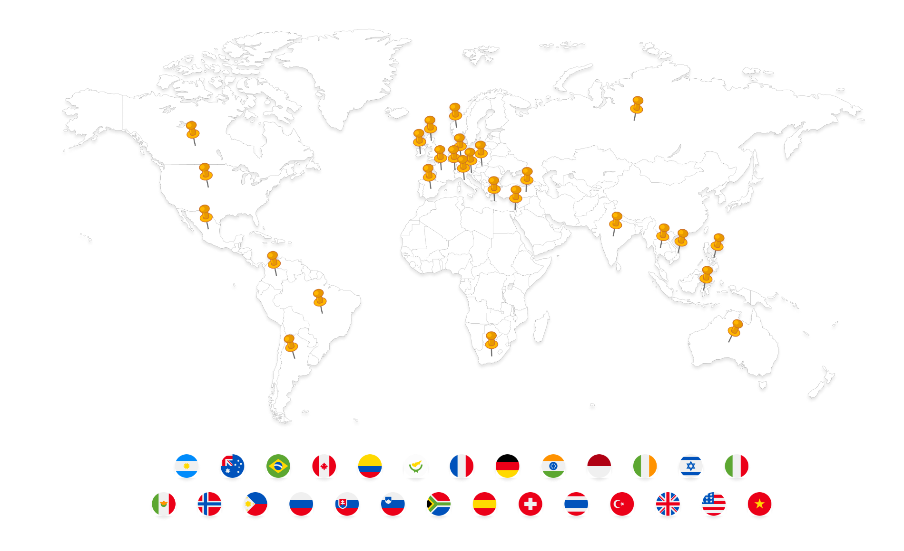
Where are you located?
Notes:
Welcome – when nothing is shared, fillert

Slide 4
How are you feeling about this topic?

Slide 7
Single choice
A
B

Slide 8
Single choice
A
B
C

Slide 9
Single select
A
B
C
D

Slide 10
Single choice
A
B
C
D
E

Slide 11
Multiple choice
A
B

Slide 12
Multiple choice
A
B
C

Slide 13
Multiple choice
A
B
C
D

Slide 14
Multiple choice
A
B
C
D
E

Slide 15
What are you hoping to learn in this course (in one word)?

Slide 16
Warm-up
How do you learn best?
Alone, in a quiet spot
With background noise like chatter or music
With others, discussing content
In a lecture
When teaching others

Slide 17
It’s good to be back!
Summarize your summer experience in one word

Slide 18
Where are you located? (in one word)

Slide 19
Where were you born? (in one word)

Slide 20
What is your level of understanding of this concept?
Novice
Basic
Expert
Solid

Slide 21
Would you rather work on this project independently or in a group?
Independently
In a group

Slide 22
After discussing at your table, would you like to change your answer to the original question?
Notes:
A la Eric Mazur

Slide 23
How comfortable would you feel explaining this concept to another learner?
Very comfortable
Somewhat comfortable
Not very comfortable
Not comfortable at all

Slide 24
Should I move on to the next topic, or would you like to spend more time on the current topic?
Next Topic
Current Topic

Slide 25
Do you agree (Thumbs Up) or disagree (Thumbs Down)?

Slide 26
Agree (Thumbs Up), Disagree (Thumbs Down) or Unsure (Thinking)?

Slide 27
What is your mood today?

Slide 28
Rate the presentation from 1-5 stars

Slide 29
Select one by clicking on the letter of your choice
"app"Beach" by Sean MacEntee is licensed under CC BY 2.0
"Mountain.." by MinutesAlone is licensed under CC BY 2.0

Slide 30
Select one by clicking on the letter of your choice
Dog
Cat

Slide 31
Select one by clicking on the letter of your choice
Under
Over

Slide 32
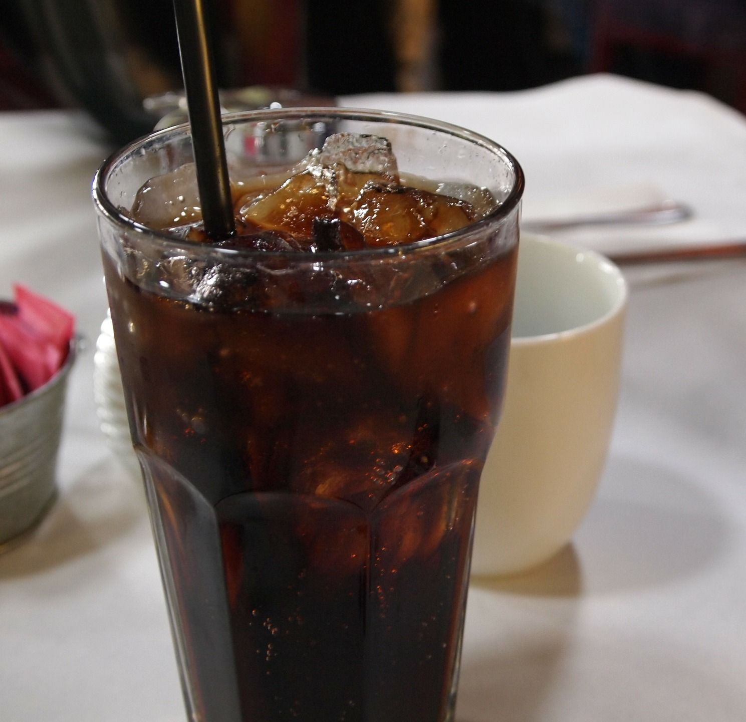
Select one by clicking on the letter of your choice
Coke
Pepsi

Slide 33
Select one by clicking on the letter of your choice
Fusion
Fission

Slide 34
Select one by clicking on the letter of your choice
Poems
Novels

Slide 35
Select one by clicking on the letter of your choice
Insert first choice here
Insert second choice here
Notes:
You can use this slide and
Cut and paste the QR codes onto your slide
Click the sticker button to launch

Slide 36
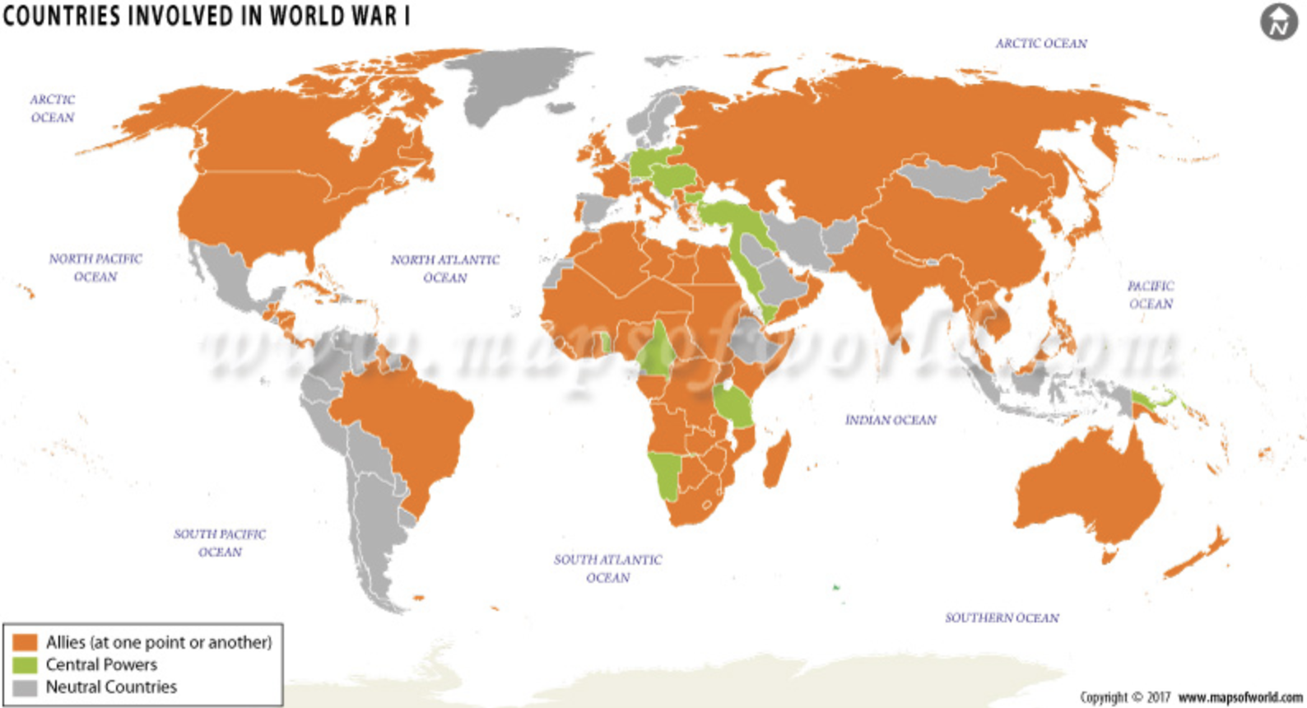
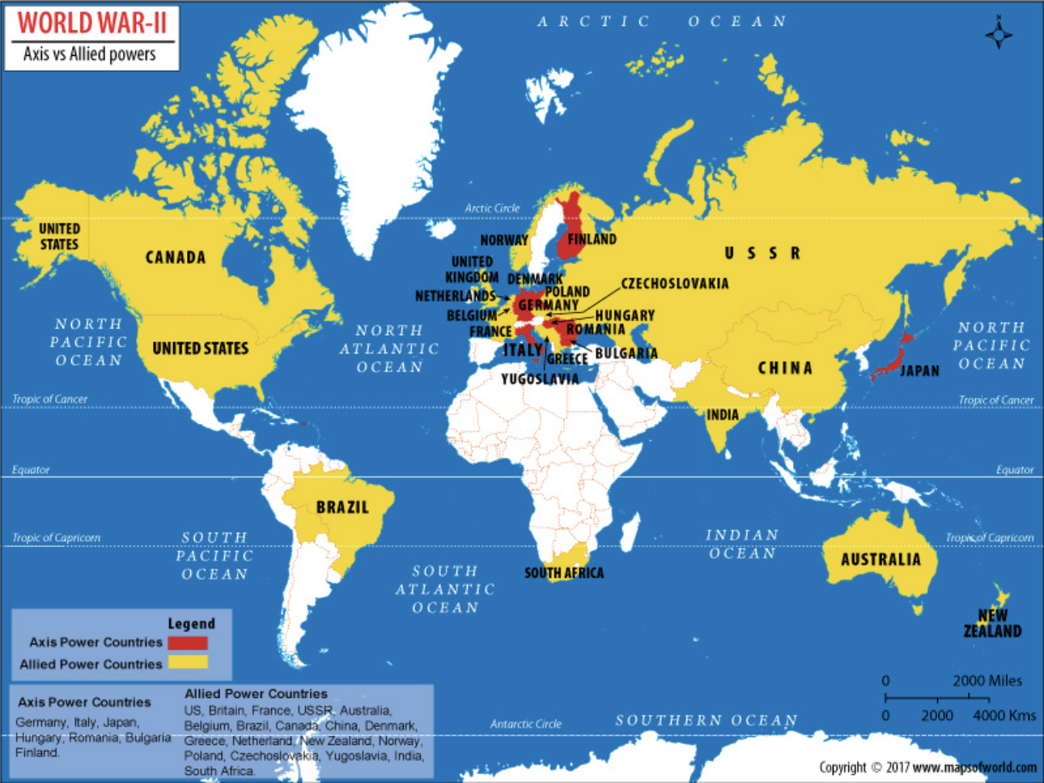
Select one by clicking on the letter of your choice
World War I
World War II

Slide 37
Additional pair ideas:
Board games or card games?
Car or truck?
Physical book or ebook?
Country or city?
Delivery or sit-down restaurant?
Hot or cold?
Baseball or basketball?
New phone or new laptop?
Plastic or glass?
Vacation or staycation?
Television series or movie?
Pancakes or waffles?
Morning or night?
Tacos or wings?
Shower or bath?
Cake or pie?
Call or text?
Sausage or bacon?
Coffee or tea?
Zip-up or pullover hoodie?

